Slide 1
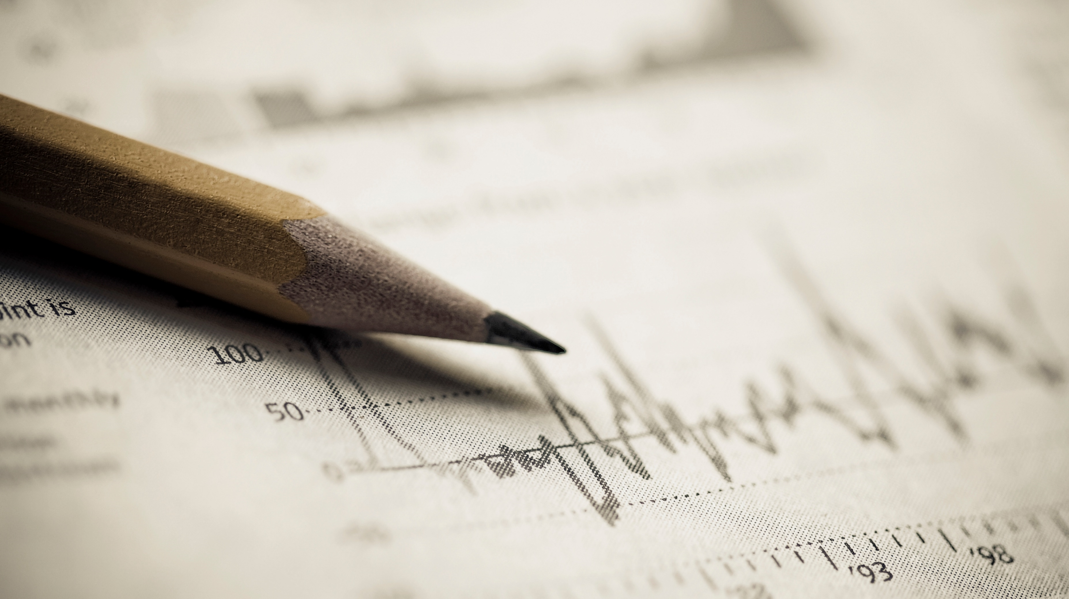
End of sprint presentation sprint 3
Rob Meulenkamp
Pascal Visser
Rienk Heins

Slide 2
Sprint 3
Goals of sprint 3
Tested algorithms
Gaussian mixture model
OPTICS
DBSCAN
Positives and negatives
Goals for sprint 4

Slide 3
Goals of sprint 3
Create a machine learning algorithm
Cluster bacteria and plastics
Outcome should be useable to show movement of cluster centers
Should have statistics to show quality of outcome

Slide 4
Algorithm 1: Gaussian mixture model
Unsupervised clustering
Gaussian distributions
EM

Slide 5
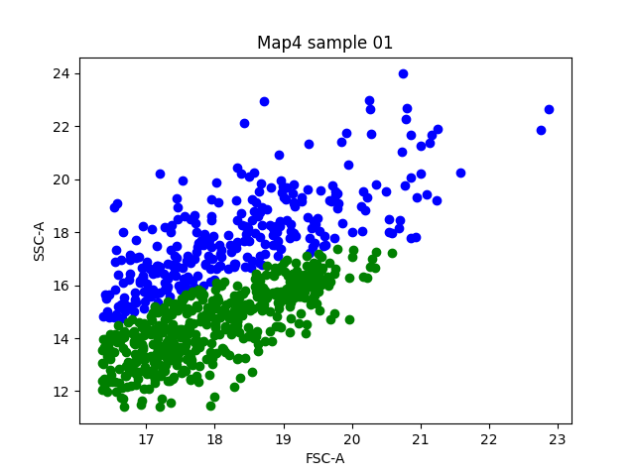
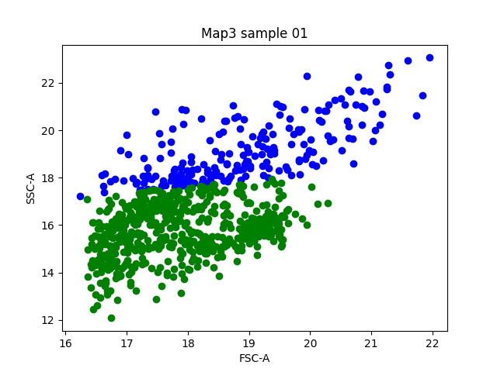
Gaussian mixture model results

Slide 6
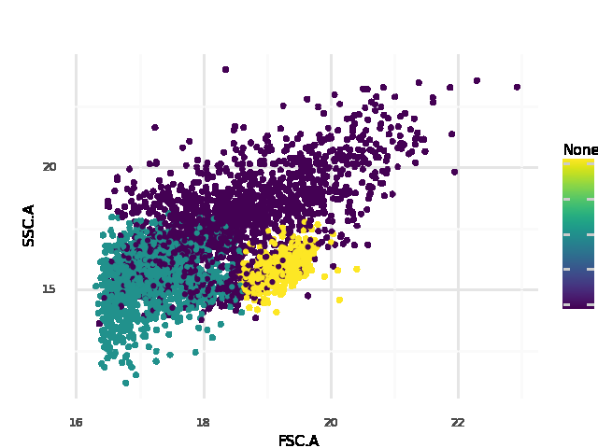
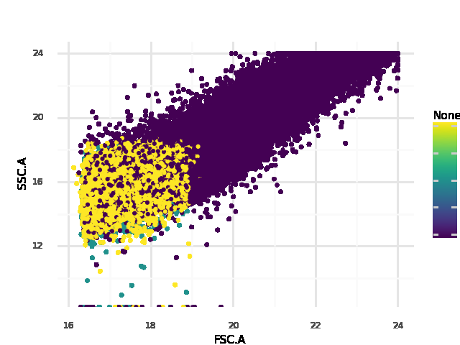
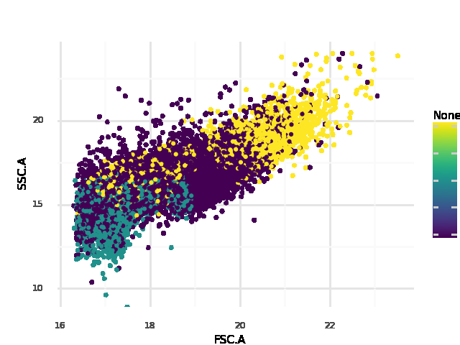
Algorithm 2: OPTICS
Density based algorithm
Looks promising on clearly separated datasets
Has a lot of problems with overlap

Slide 7
Algorithm 3: DBSCAN
Density-based spatial clustering of applications with noise

Slide 8
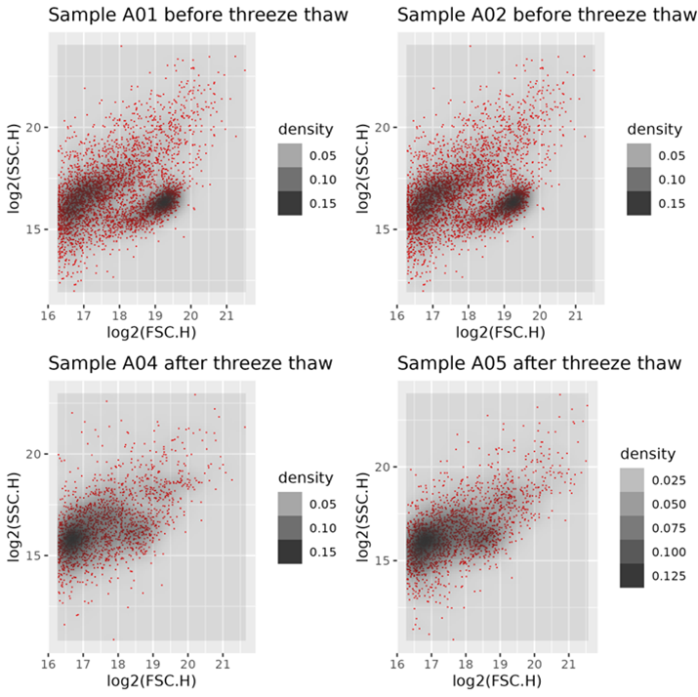
Why Density based Scan?
Lots of data With dense regions
Quicker than OPTICS
Simple, but effective

Slide 9
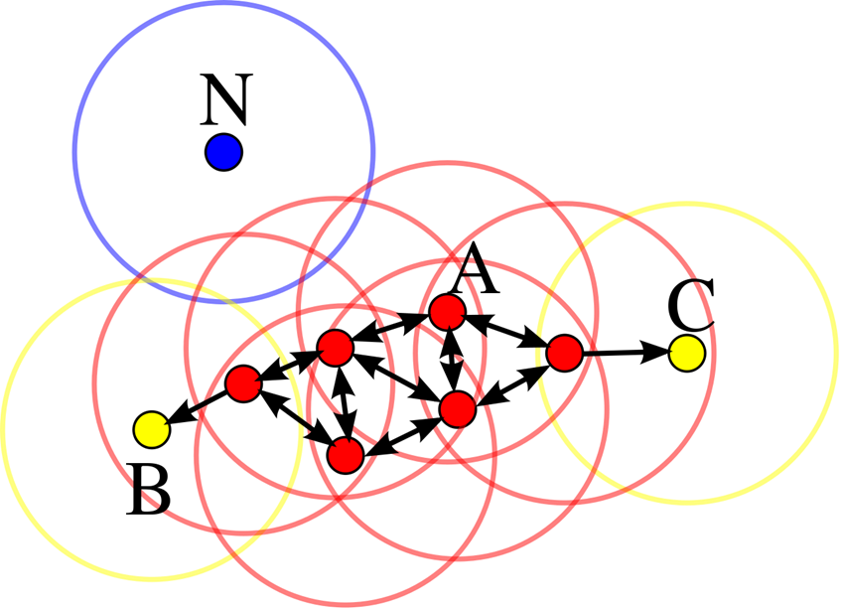
Dbscan algorithm
EPS
MinPts
Unsupervised

Slide 10
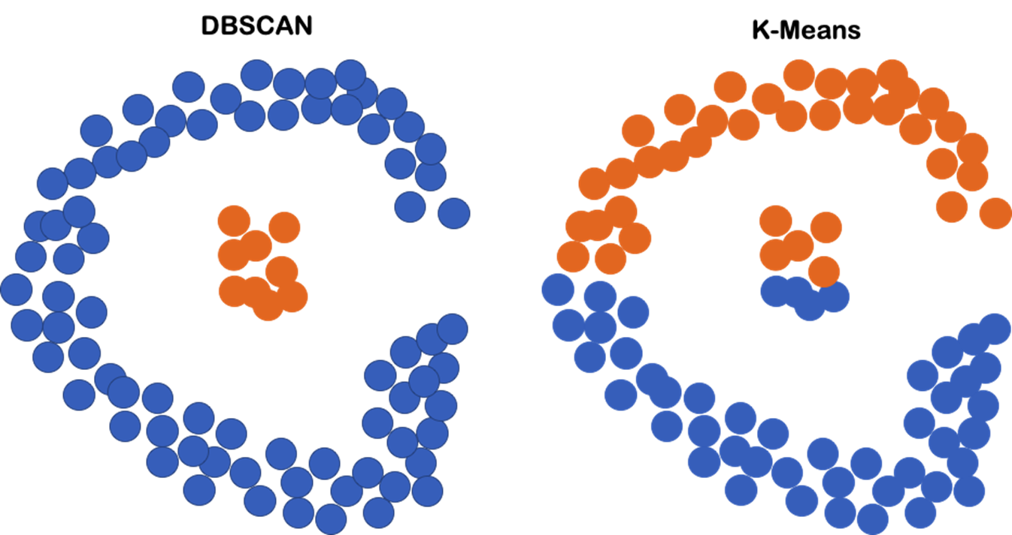

Slide 11
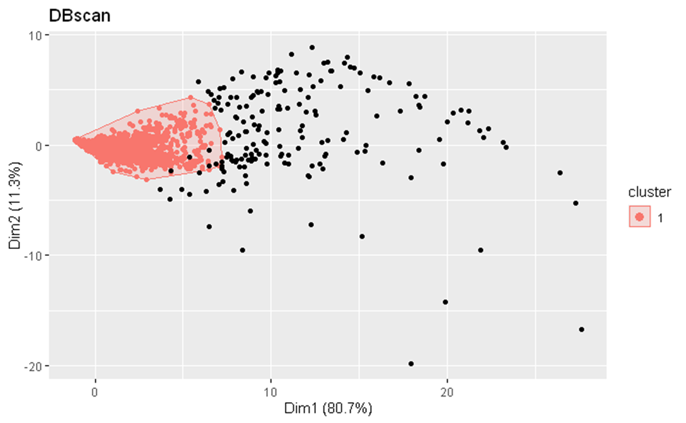
Results with DBscan
Capture of dense region
Mistake with boarder points
Auto PCA

Slide 12
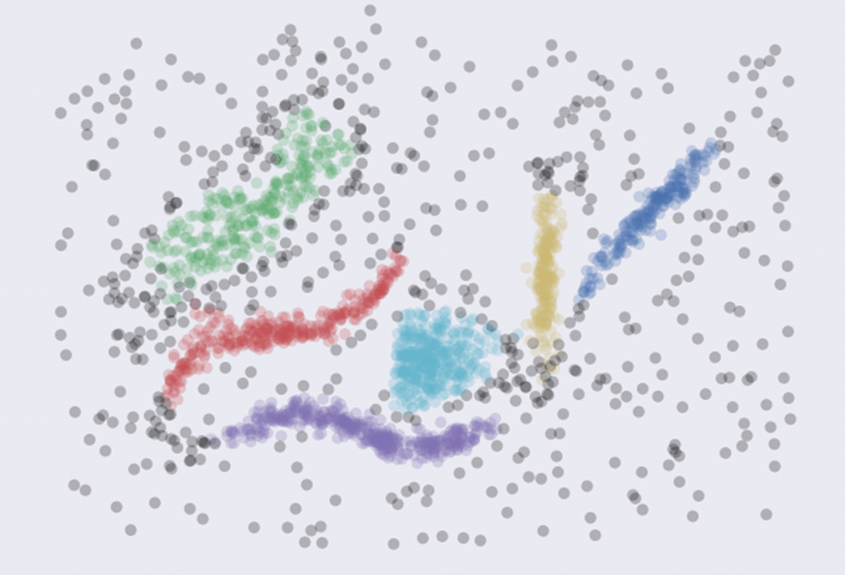
HDBscan
Variant of Dbscan
Can handle different shapes
Decision tree
MinPts

Slide 13
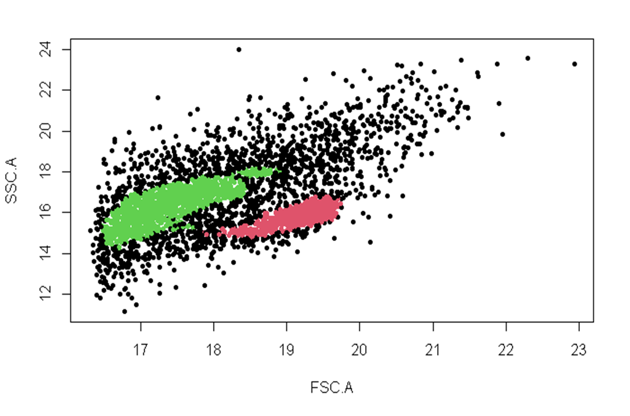
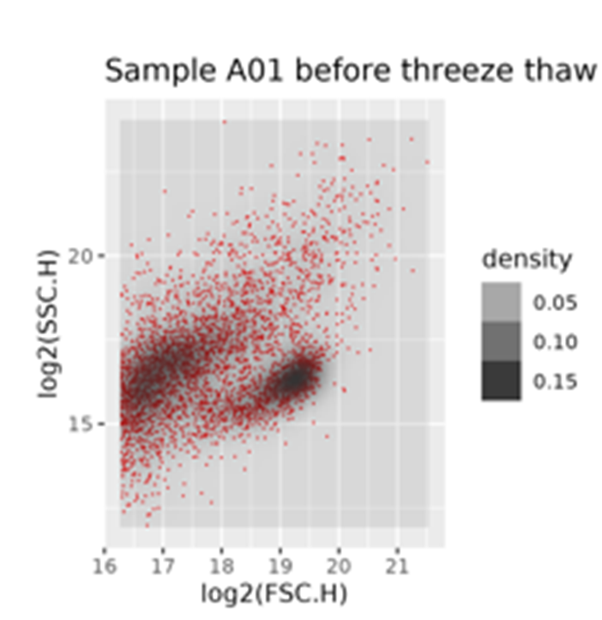

Slide 14
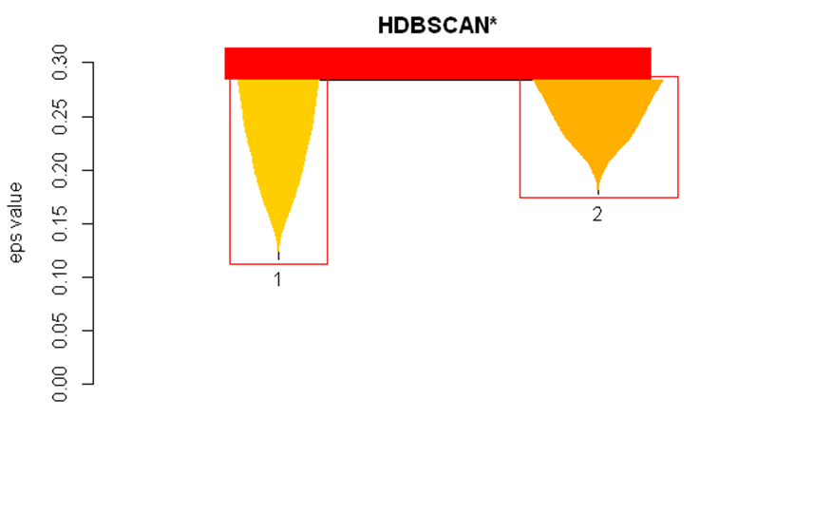

Slide 15
Final decision

Slide 16
Positives and negatives
Positives:
DBSCAN results
Clear plan for sprint 4
Negatives:
Optics and GMM both didn’t create desired output
Still a decent number of points not clustered with final algorithm

Slide 17
Goals for sprint 4
Optimizing the algorithm
Creation of an application for results and use of new datasets
Should give movement of clusters for degradation
Give statistics about the quality of the results
Useable for the lab

Slide 18

Questions?

